Slide 1

The Machine Learning Process
How do I use pandas with scikit-learn to create Kaggle submissions?
Dr. Reza Dibaj

Slide 2
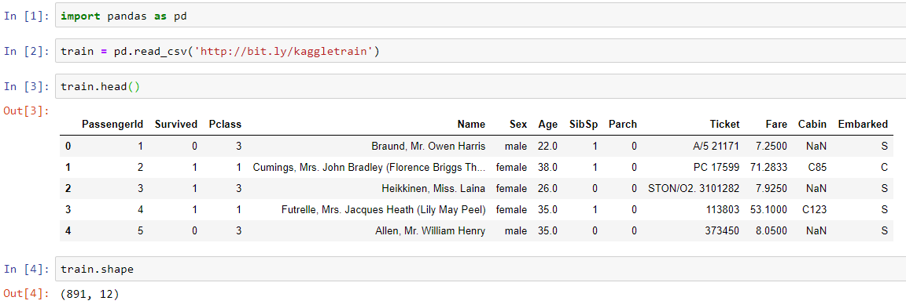
Using pandas with sklearn
Let’s pull up an example dataset as follows:
Notes:
import pandas as pd
train = pd.read_csv('http://bit.ly/kaggletrain’)
train.head()
train.shape

Slide 3
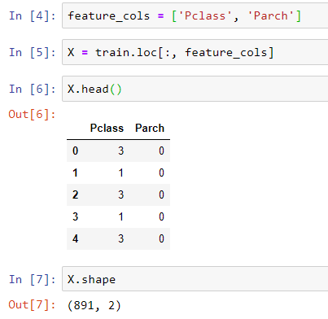
Using pandas with sklearn
We create two features that our model will learn from:
Notes:
feature_cols = ['Pclass', 'Parch’]
X = train.loc[:, feature_cols]
X.head()
X.shape

Slide 4

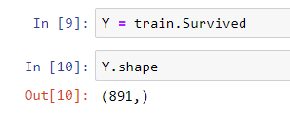
Using pandas with sklearn
Now, we create our target factor, which shapes our response.
This is what we are going predict….
sklearn will understand the X and Y objects as long as they are numeric and in right shapes.
Notes:
Y = train.Survived
Y.Shape

Slide 5
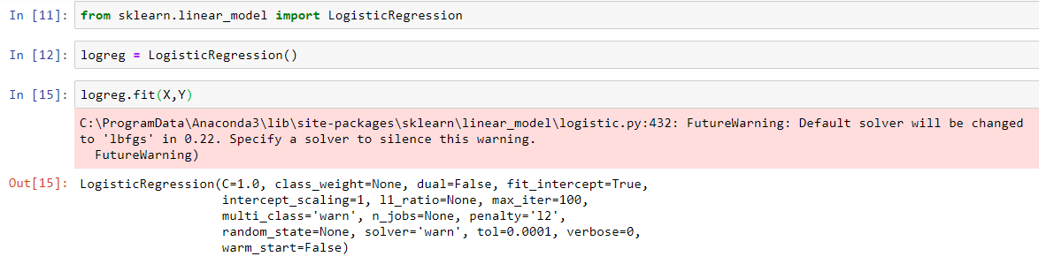
Using pandas with sklearn
Here is our quick-code to create a classification model:
Notes:
from sklearn.linear_model import LogisticRegression
logreg = LogisticRegression()
logreg.fit(X,Y)

Slide 6
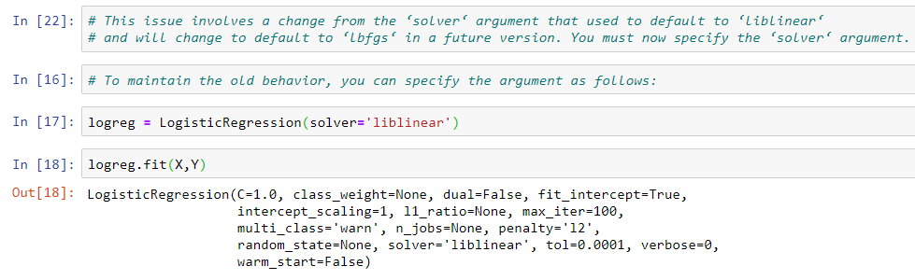
Using pandas with sklearn
In order to silent the warning….
Notes:
logreg = LogisticRegression(solver='liblinear’)
logreg.fit(X,Y)

Slide 7
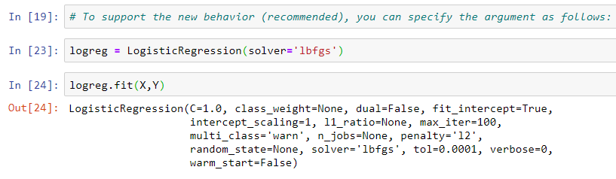
Using pandas with sklearn
And a newer method to resolve the issue…
Notes:
logreg = LogisticRegression(solver='lbfgs’)
logreg.fit(X,Y)

Slide 8
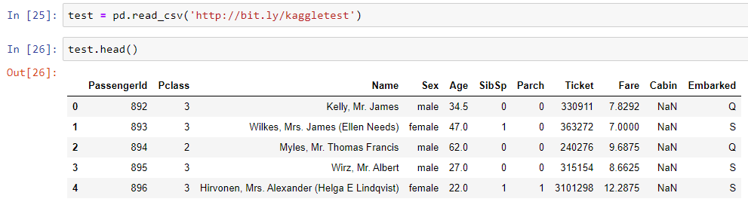
Using pandas with sklearn
The next step is reading the test-data that we are going to make our predictions on:
We can see that we do not have the Survived column as we want to predict it.
Notes:
test = pd.read_csv('http://bit.ly/kaggletest’)
test.head()

Slide 9
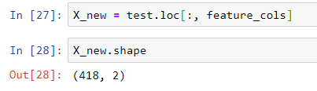
Using pandas with sklearn
We create a new X for our testing data:
One more line of code and we will have our prediction:
Notes:
X_new = test.loc[:, feature_cols]
X_new.shape
new_pred_class = logreg.predict(X_new)

Slide 10
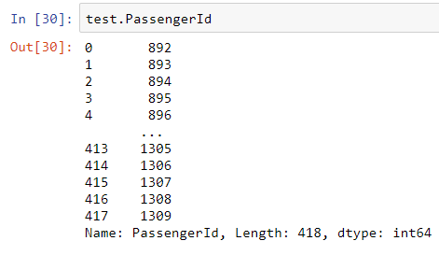
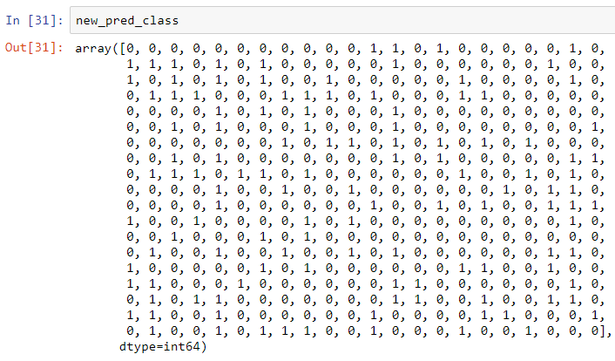
Using pandas with sklearn
And now we need to save the result in a CSV file which contains the PassengerId and the predicted classes. The following shows the content of each column:
Notes:
test.PassengerId
new_pred_class

Slide 11
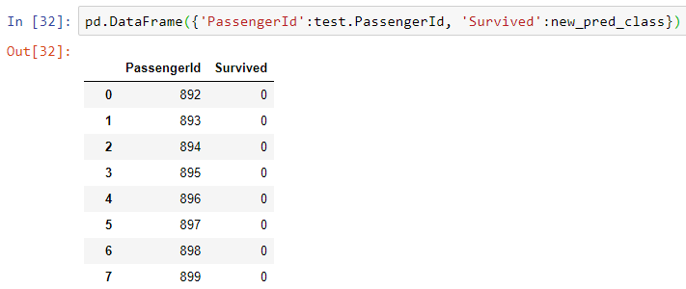
Using pandas with sklearn
Now creating a CSV file with two columns, using a dictionary:
Notes:
pd.DataFrame({'PassengerId':test.PassengerId, 'Survived':new_pred_class})

Slide 12
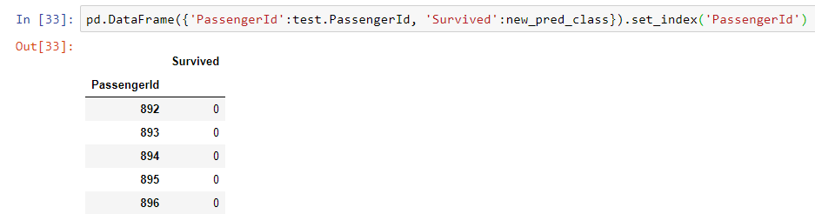
Using pandas with sklearn
As the dictionary has no order, the safest way to make the order is to set the ‘PassengerId’ as index:
Notes:
pd.DataFrame({'PassengerId':test.PassengerId, 'Survived':new_pred_class}).set_index('PassengerId')

Slide 13
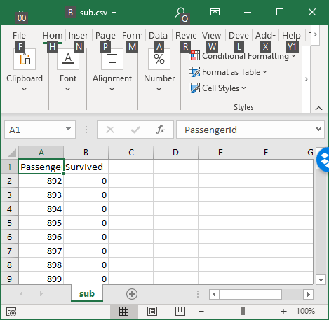
Using pandas with sklearn
And the final part is the easiest one to create a CSV file, using a to_csv() method, and passing the file name as its parameter:
Notes:
pd.DataFrame({'PassengerId':test.PassengerId, 'Survived':new_pred_class}).set_index('PassengerId').to_csv('sub.csv’)

Slide 14

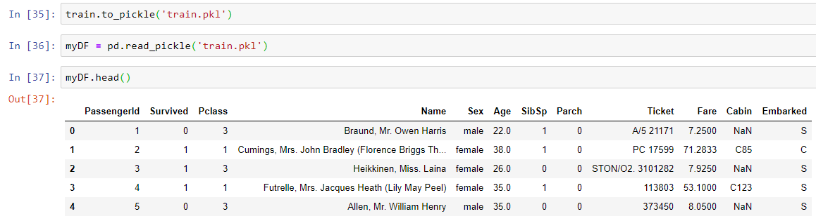
Bonus Tip
The easiest way to save a DF in pandas is to pickle it as follows:
Notes:
train.to_pickle('train.pkl’)
myDF = pd.read_pickle('train.pkl’)
myDF.head()

Slide 15

Thank you
Question?
To be
Not to be

